Slide 1
Heroes with Capes
Dennis Nayandin

Slide 2
Gameplay / GUI / Music
Gameplay:
5 playable Characters
Enemies will be all around a maze type map, they will shoot on sight when you are seen.
Each enemy type (human, robot, alien) take damage differently among playable characters.
Game mechs:
W A S D (move around)
Left Click to shoot where pointing to
Gui:
(1-5): Selects different characters to play as.
(Q | E): Special abilities each character will have.
({Ammo}): Displays how much ammo the current character has.
(Top of Screen): Displays the score/level info/time
Music: Will be similar to Cyber Punk ~ Edm/Synth type of music.

Slide 3
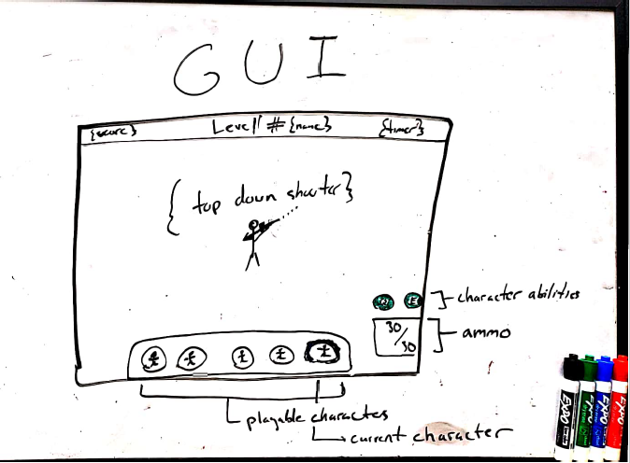
GUI
- Top bar: {score} {Level # + name} {timer}
Bottom bar: {5 character selection}
By Pressing 1-5, you can change characters
Bottom right corner: ammo + ability cooldown
On Screen: the top down shooter gameplay

Slide 4
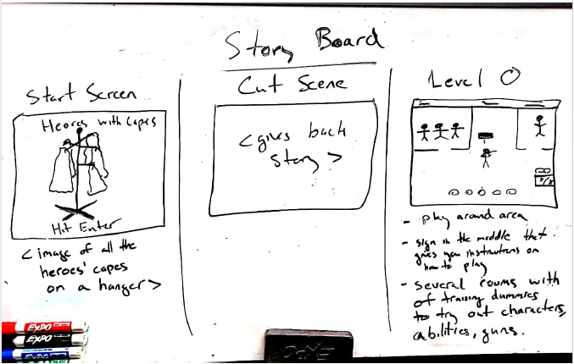
Story Board - 1

Slide 5
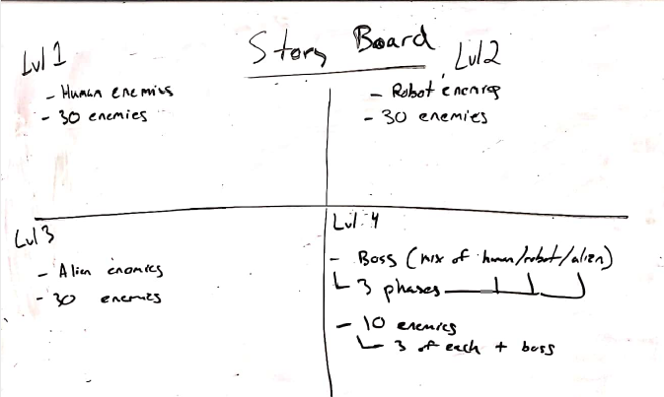
Story Board – 2

Slide 6
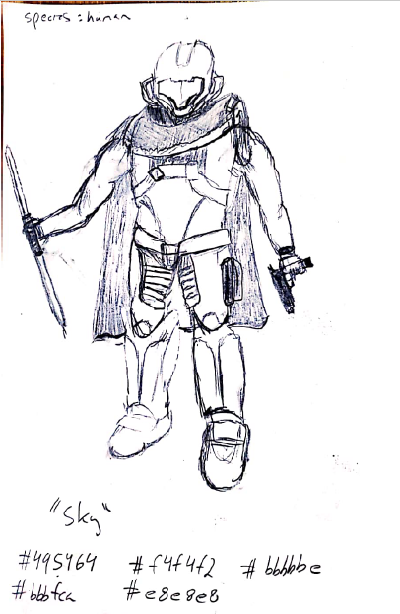
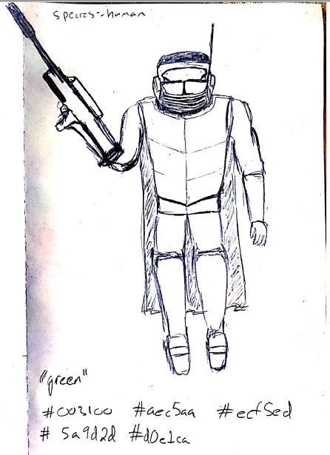
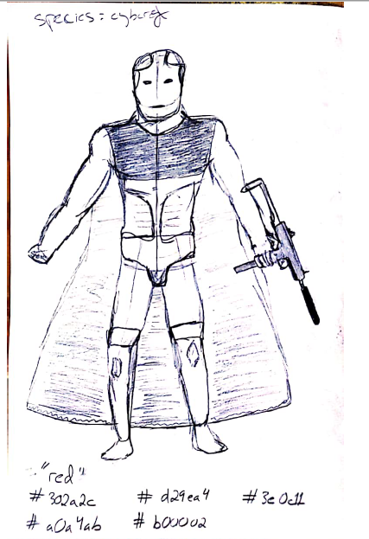
Concept Art - 1

Slide 7
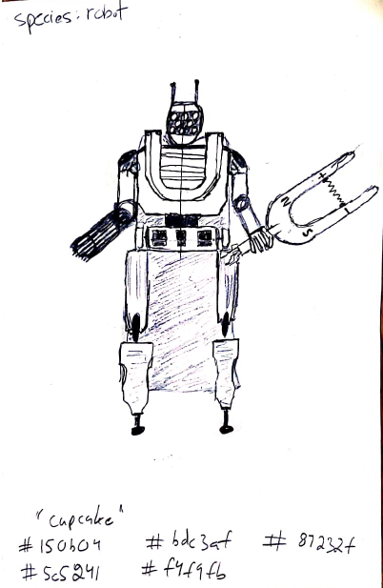
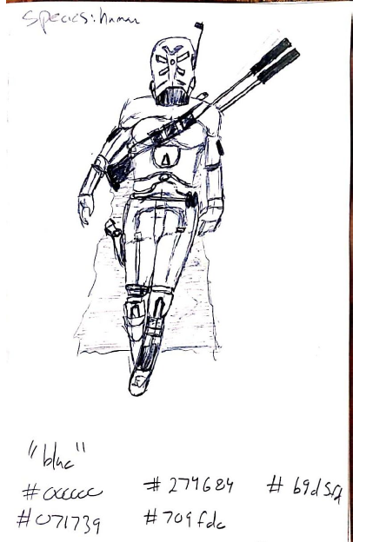
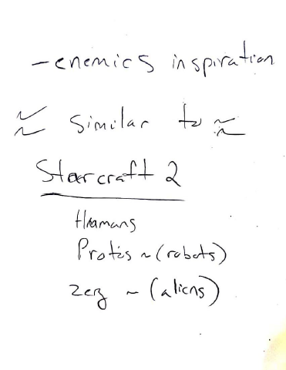
Concept Art - 2

Slide 8
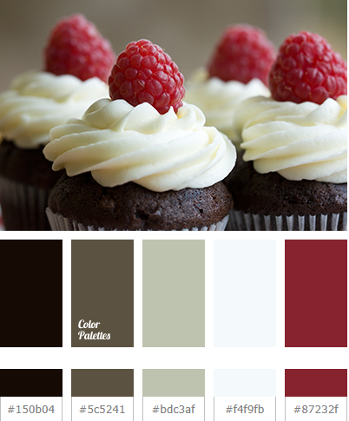
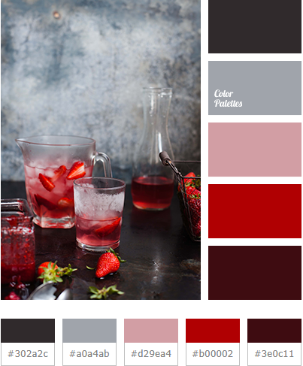
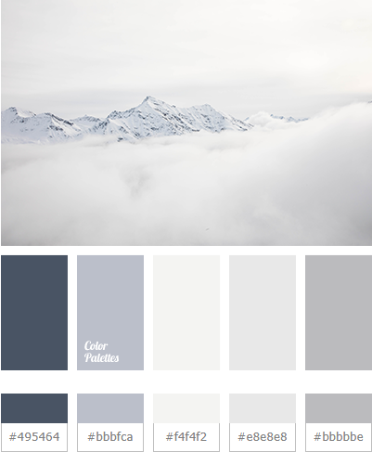
Hex Colors Reference - 1

Slide 9
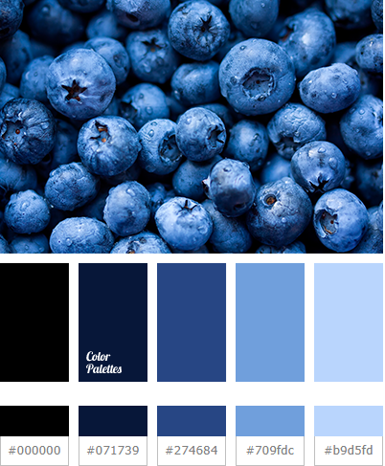
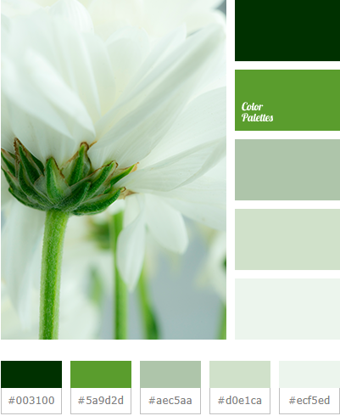
Hex Colors Reference - 2

Slide 10
Sprites
Obviously the concept art will not be reproduced when creating pixel versions of the characters and enemies, they will be much more simplified (in process)
Maps: Each map will be a little maze like (in process)

Slide 11
Sky

Slide 12
Cupcake

Slide 13
Green

Slide 14
Red

Slide 15
Blue

